Slide 1
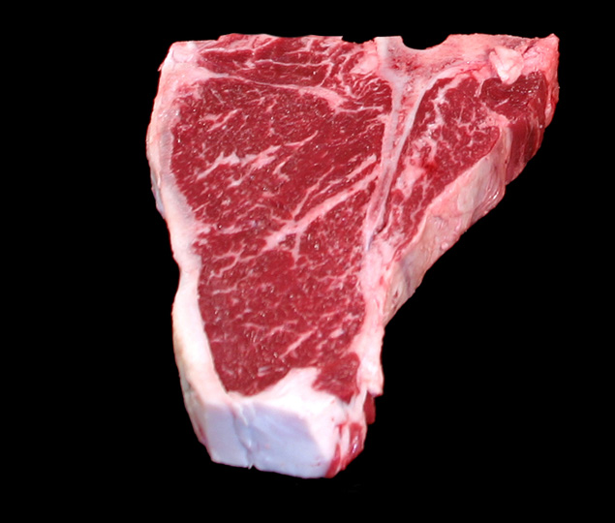
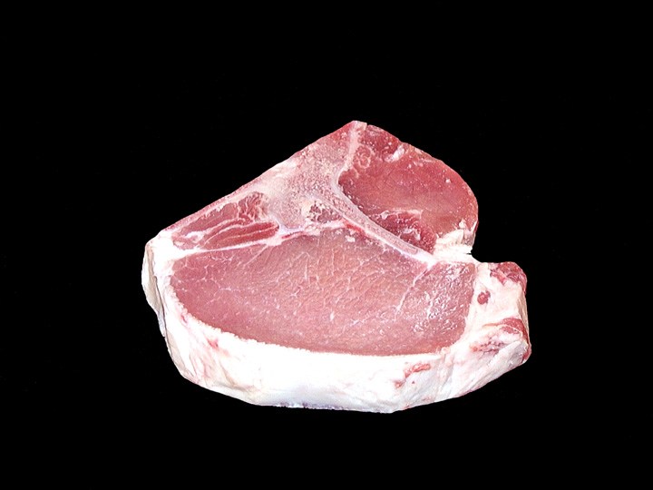
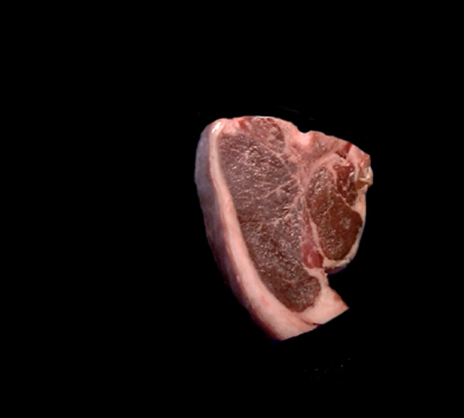
FFA Meats Retail ID
Linda Carter
Westbrook Walnut Grove FFA
carter@mvtvwireless.com

Slide 2
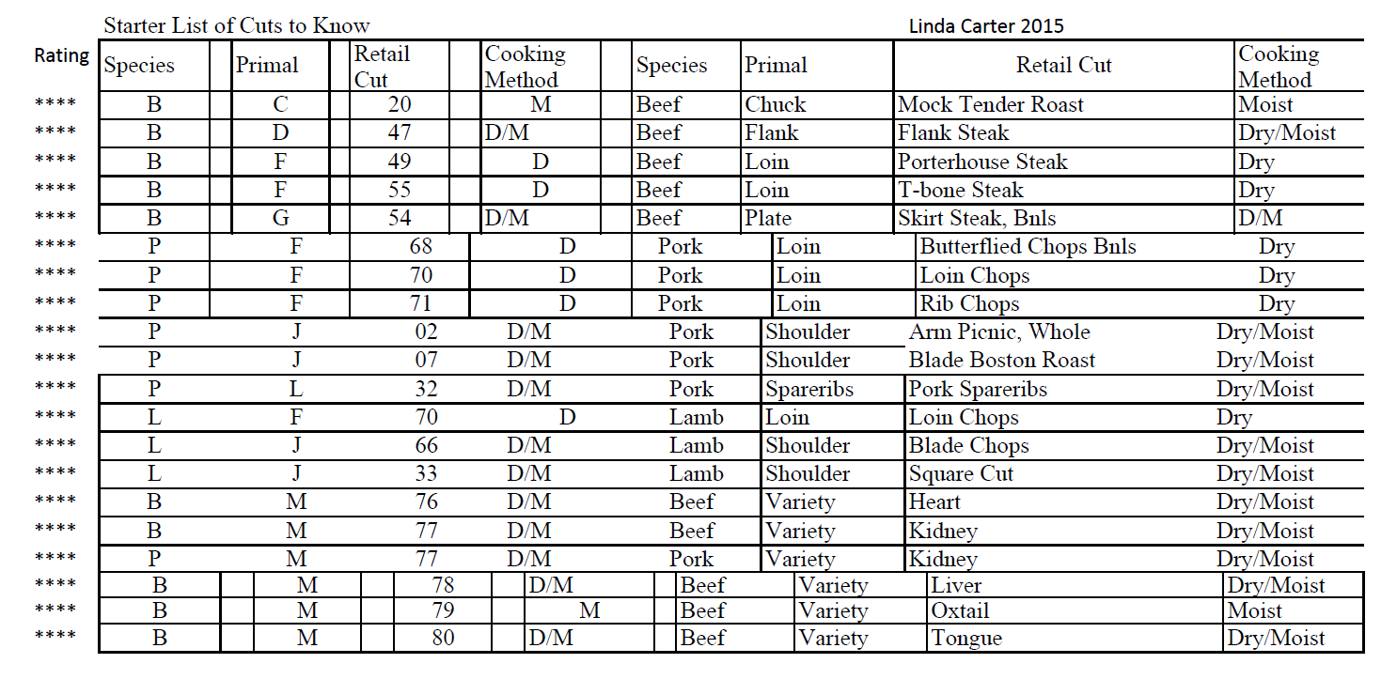
Starter List of Cuts to know:
****Twenty-4-Star Cuts

Slide 3
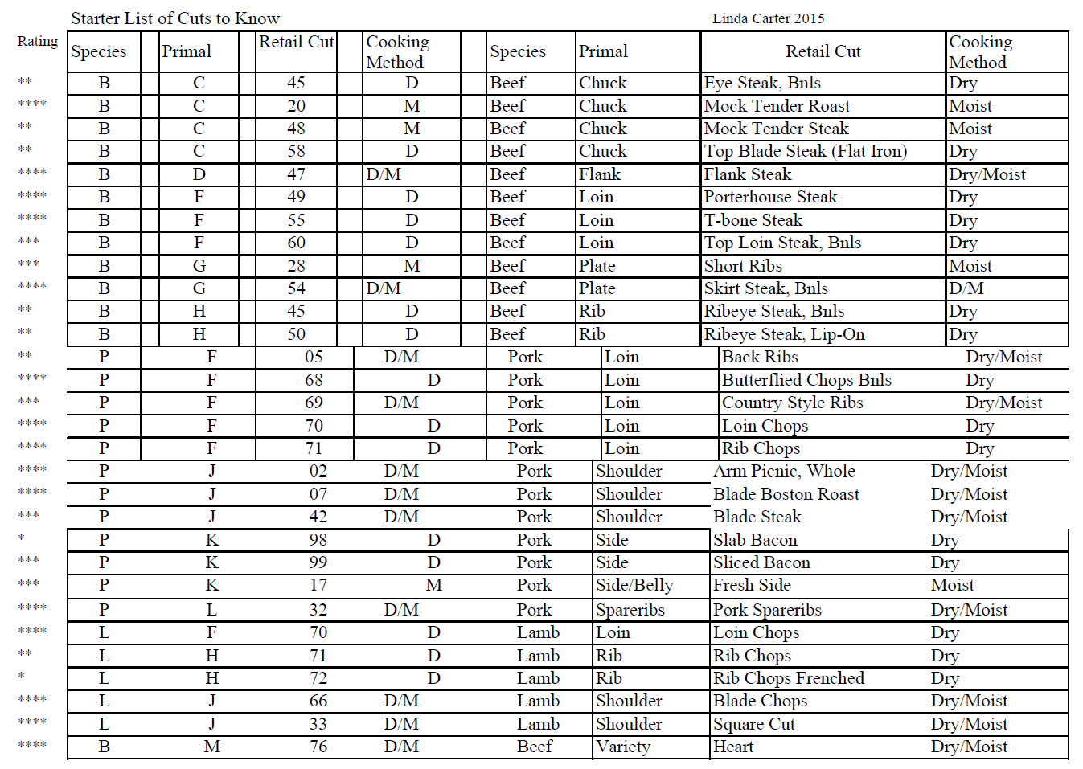
Top Fourty Cuts List

Slide 5
Beef
T-Bone
Steak
Pork
Loin
Chop
Lamb
Loin
Chop

Slide 6
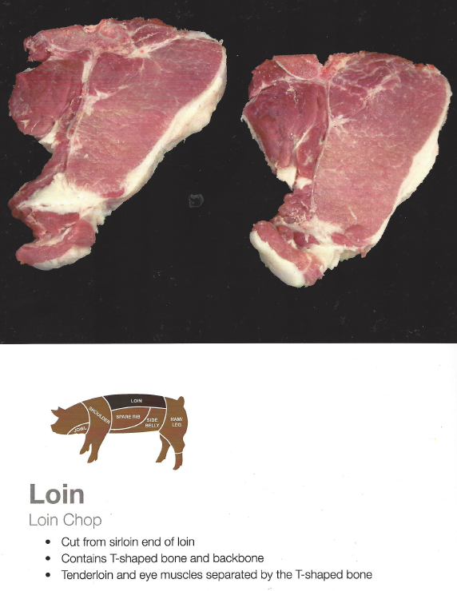
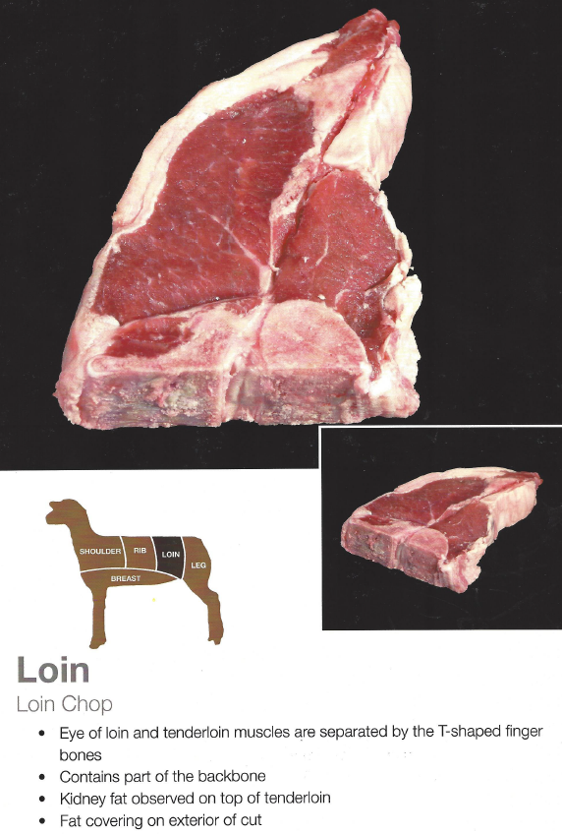

Slide 7
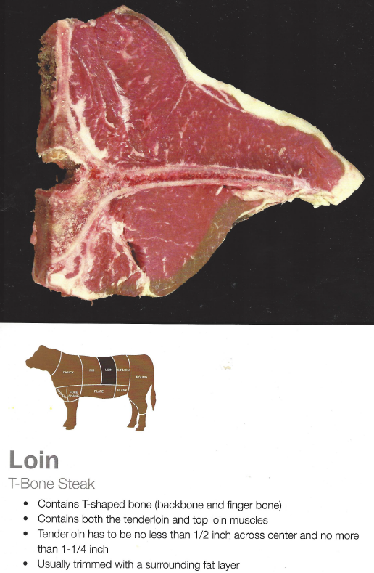
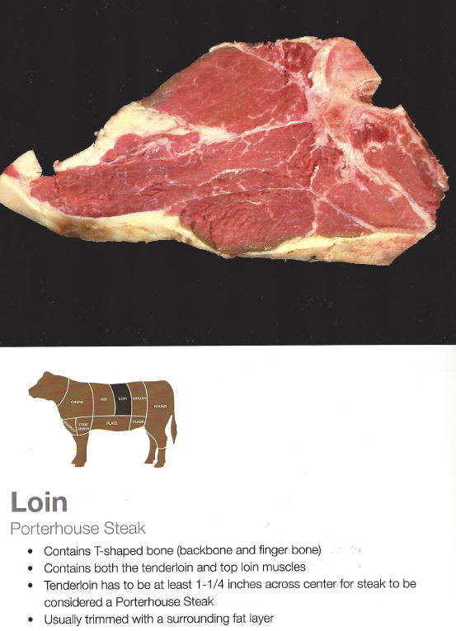

Slide 8
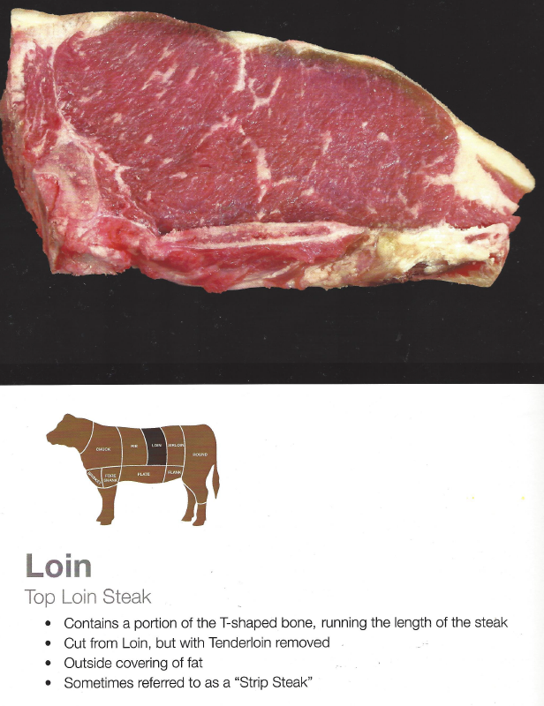
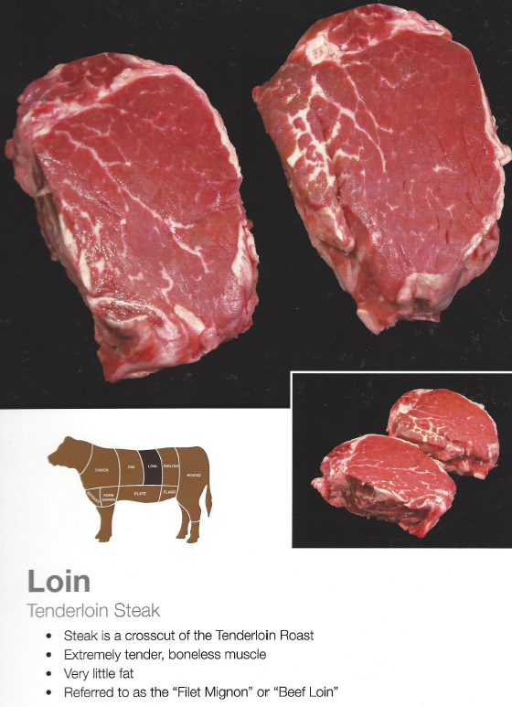

Slide 9
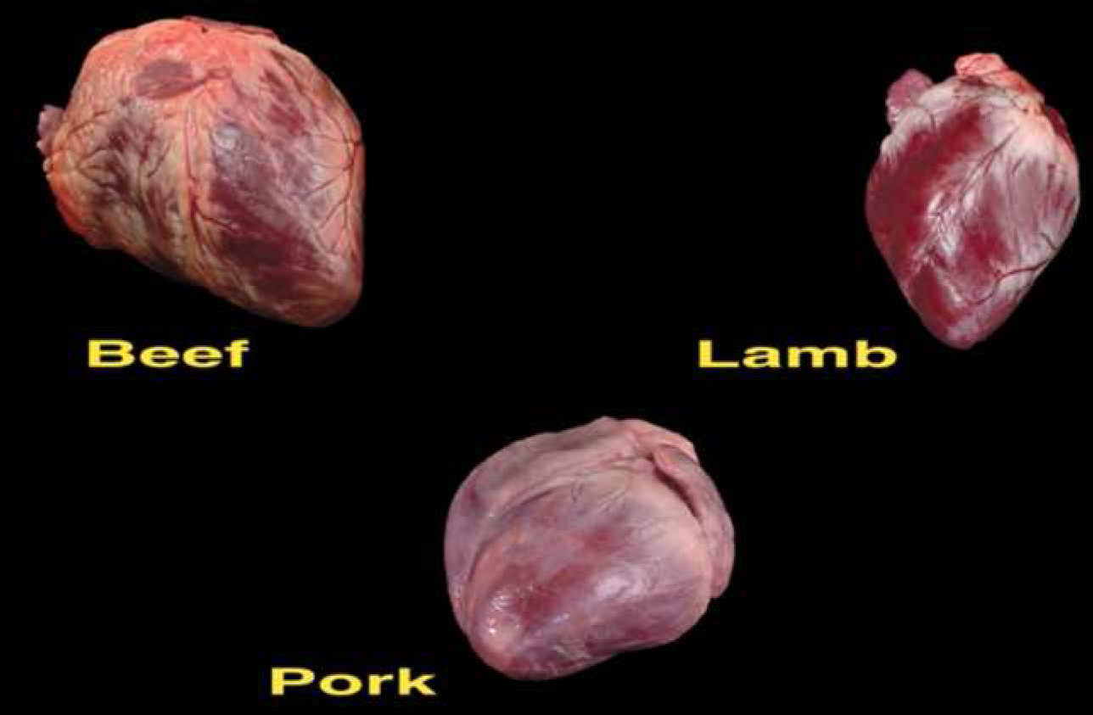

Slide 10
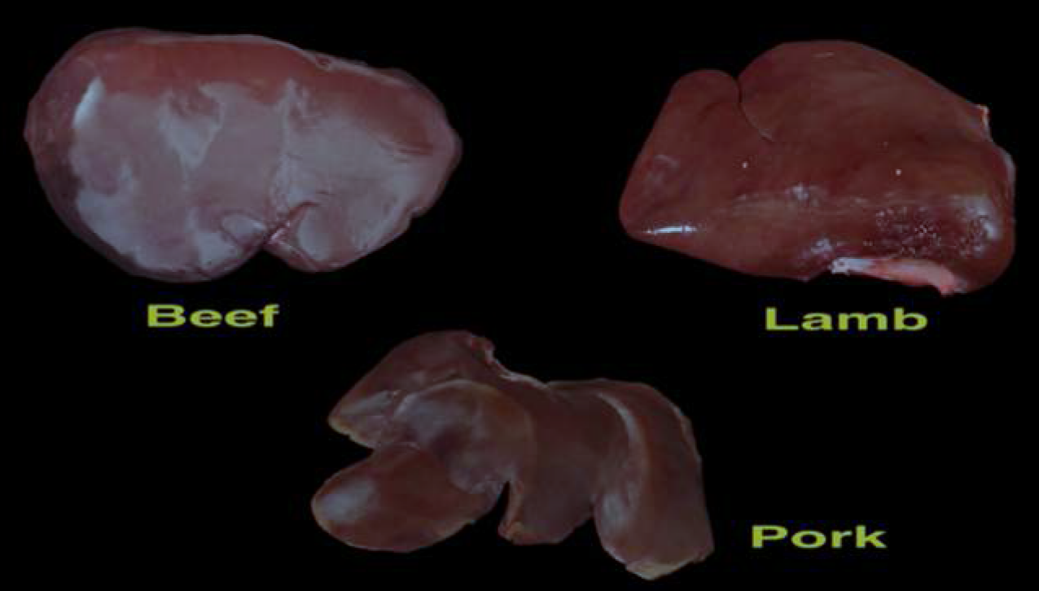

Slide 11
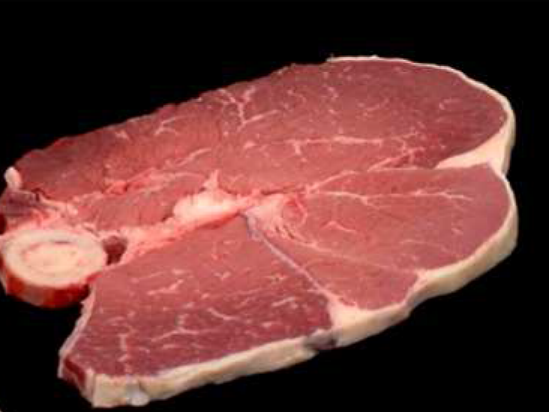
Species: Beef, Primal: Round, Retail Cut: Round Steak, Cookery: Moist

Slide 12
Top Round Steak, Bottom Round Steak, Eye of Round Steak
Top Round Steak
Eye of Round Steak
Bottom Round Steak

Slide 13
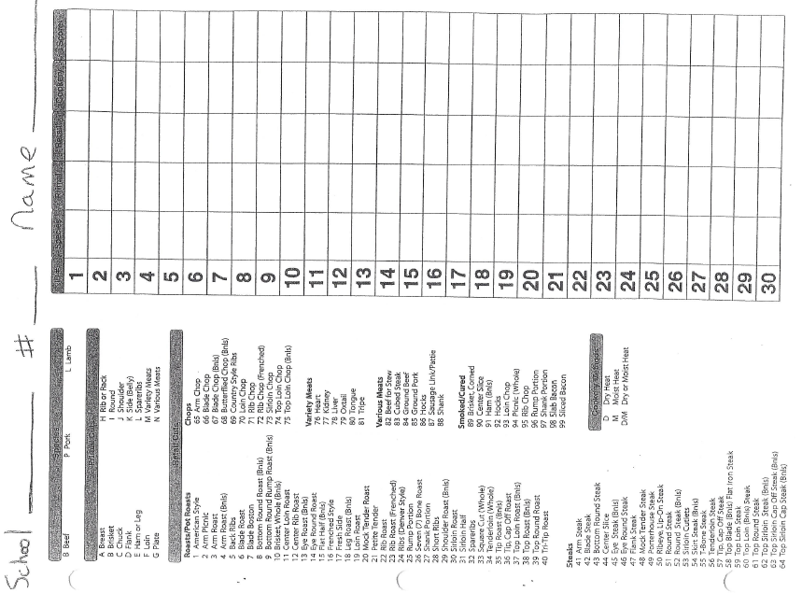

Slide 14
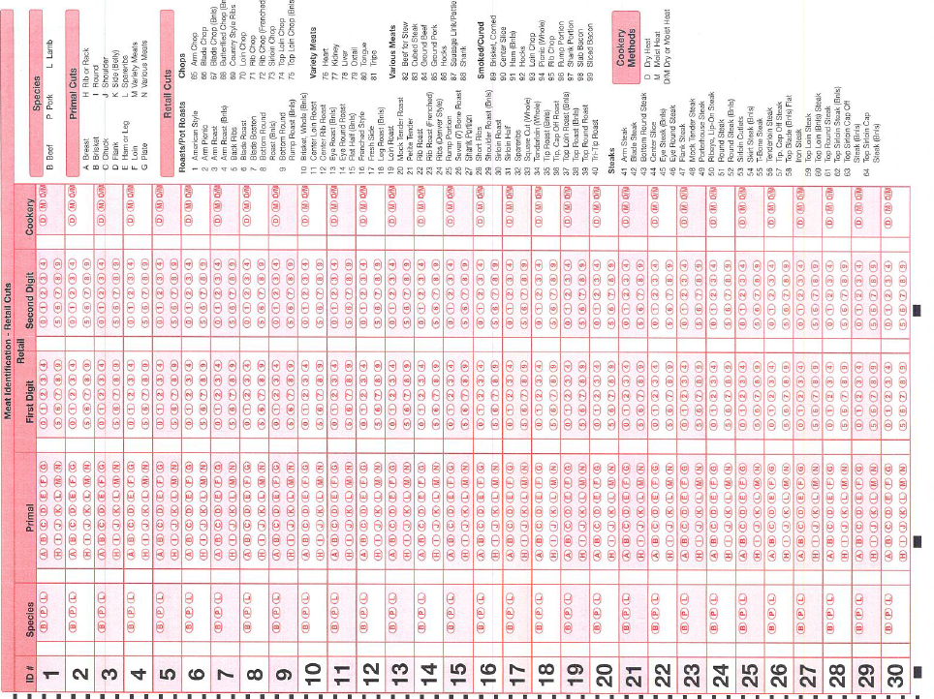

Slide 16
Reference Material
Intelliprep:
http://www.intelliprep.com/meat-id.html
Texas A & M Aggie Meats
http://aggiemeat.tamu.edu/meat-identification-pictures/
Meat Evaluation Handbook
http://www.meatscience.org/publications-resources/printed-publications/meat-evaluation-handbook
Minnesota FFA Handbook
http://cde.ffa.umn.edu/Web/CDEbooklet.htm

