Slide 1
Pork Retail ID Cuts

Slide 2
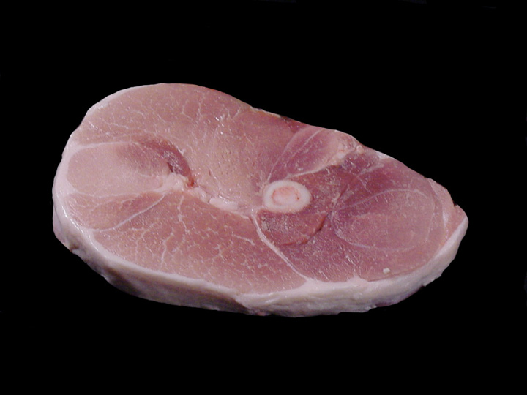
Center Slice
P – Pork
E – Ham or Leg
44 – Center Slice
D/M – Dry/Moist Cookery

Slide 3
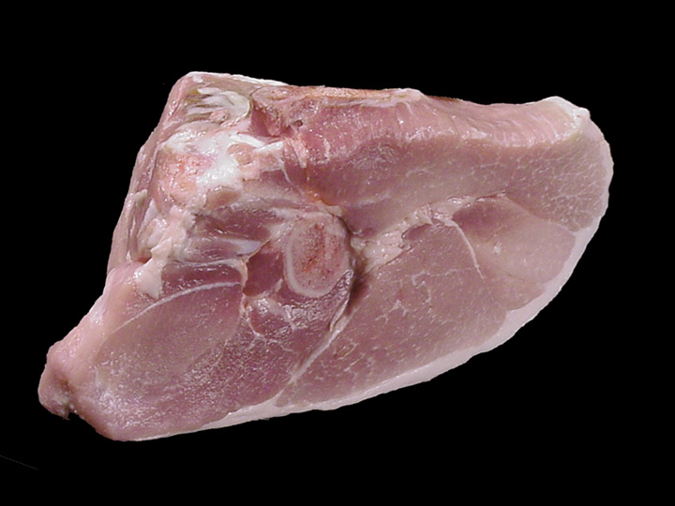
Rump Portion
P – Pork
E – Ham or Leg
25 – Rump Portion
D/M – Dry/Moist Cookery

Slide 4
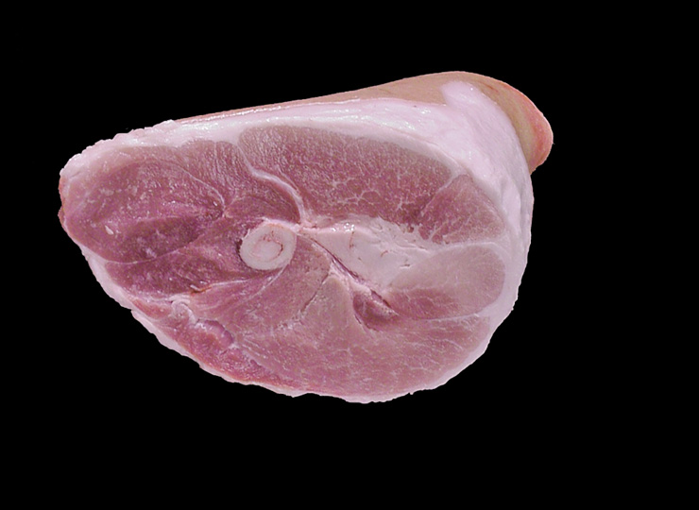
Shank Portion
P – Pork
E – Ham or Leg
27 – Shank Portion
D/M – Dry/Moist Cookery

Slide 5
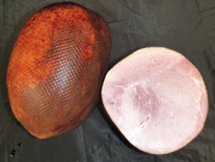
Smoked Ham (Bnls)
P – Pork
E – Ham or Leg
91 – Ham (Bnls)
D – Dry Cookery

Slide 6
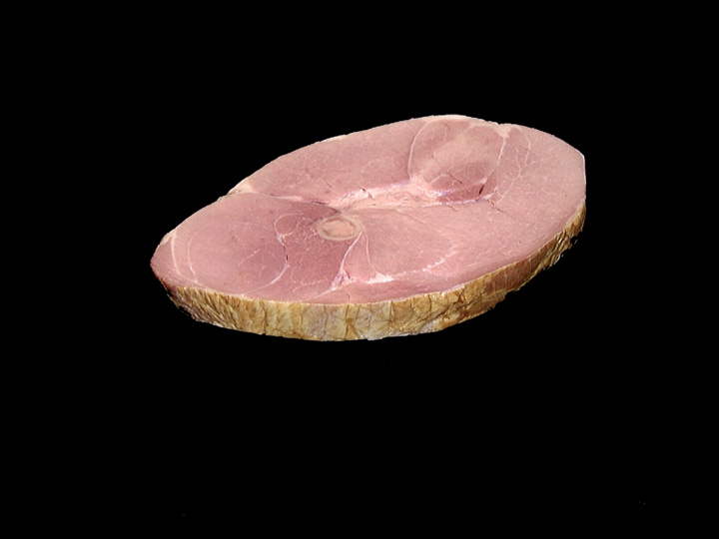
Smoked Center Slice
P – Pork
E – Ham or Leg
90 – Center Slice
D – Dry Cookery

Slide 7
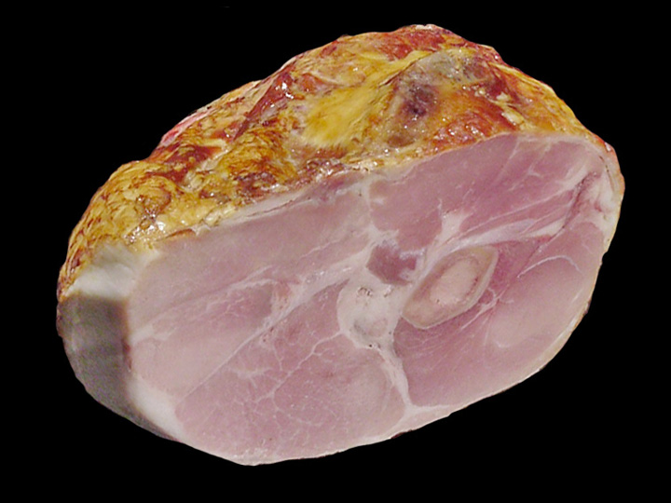
Smoked Rump Portion
P – Pork
E – Ham or Leg
96 – Rump Portion
D – Dry Cookery

Slide 8
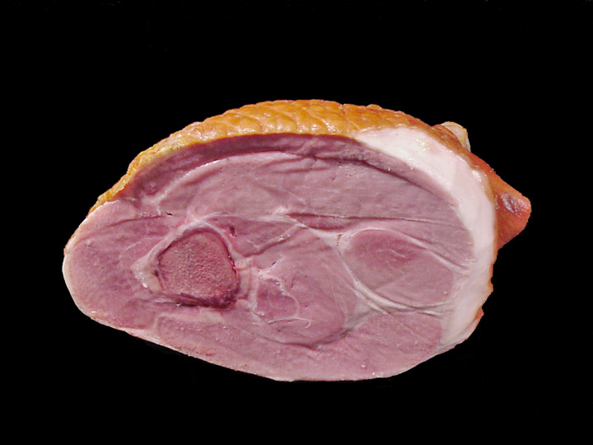
Smoked Shank Portion
P – Pork
E – Ham or Leg
97 – Shank Portion
D – Dry Cookery

Slide 9
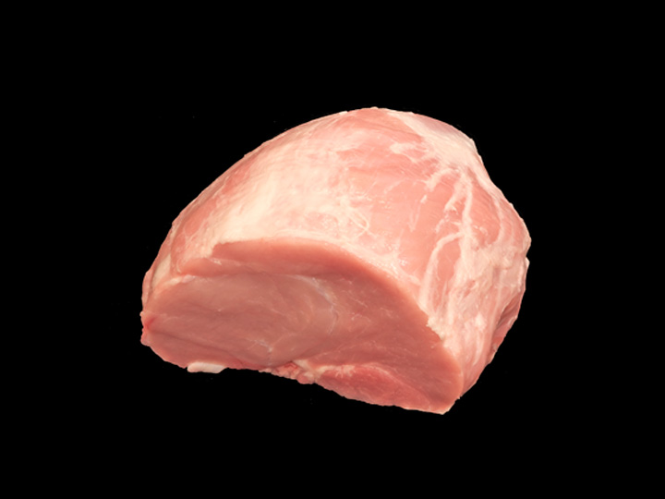
Tip Roast (Bnls)
P – Pork
E – Ham or Leg
35 – Tip Roast (Bnls)
D – Dry Cookery

Slide 10
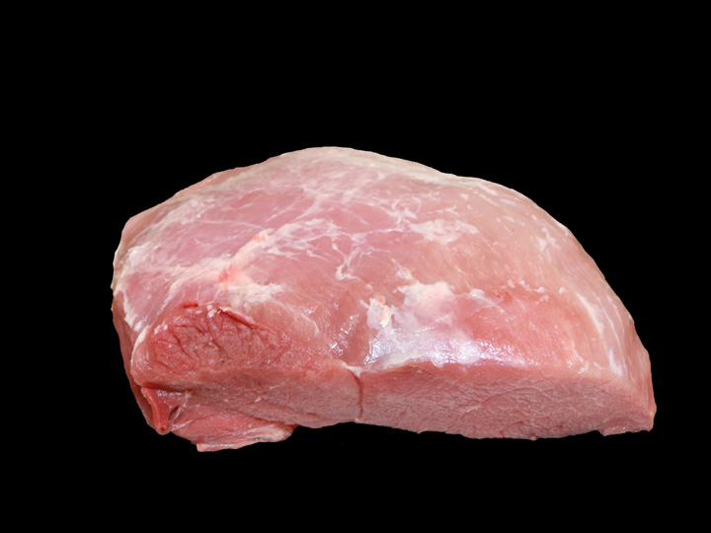
Top Roast (Bnls)
P – Pork
E – Ham or Leg
38 – Top Roast (Bnls)
D – Dry Cookery

Slide 11
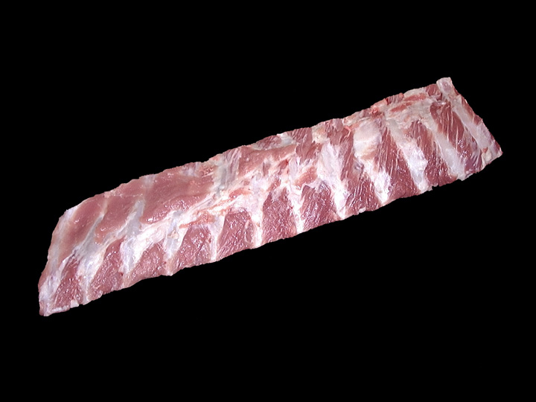
Back Ribs
P – Pork
F – Loin
05 – Back Ribs
D/M – Dry/Moist Cookery

Slide 12
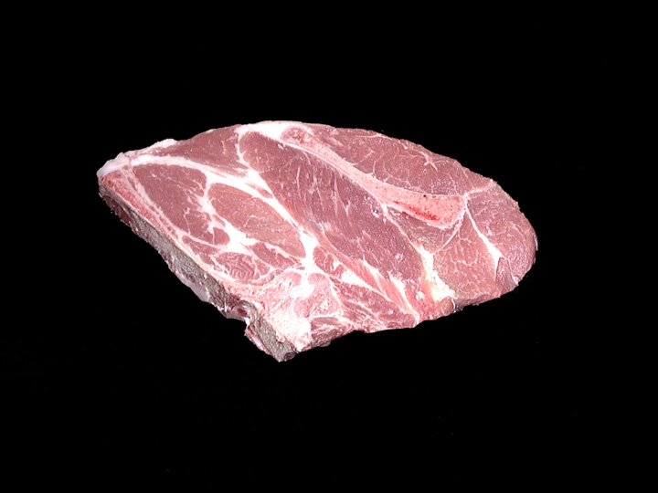
Blade Chop
P – Pork
F – Loin
66 – Blade Chop
D/M – Dry/Moist Cookery

Slide 13
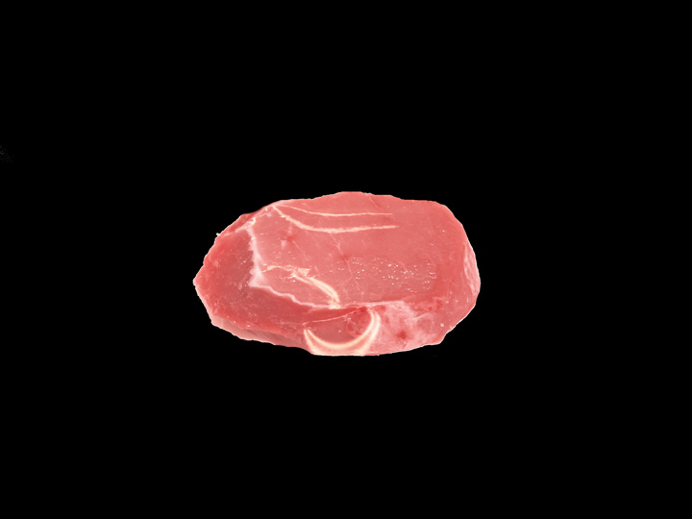
Blade Chop (Bnls)
P – Pork
F – Loin
67 – Blade Chop (Bnls)
D/M – Dry/Moist Cookery

Slide 14
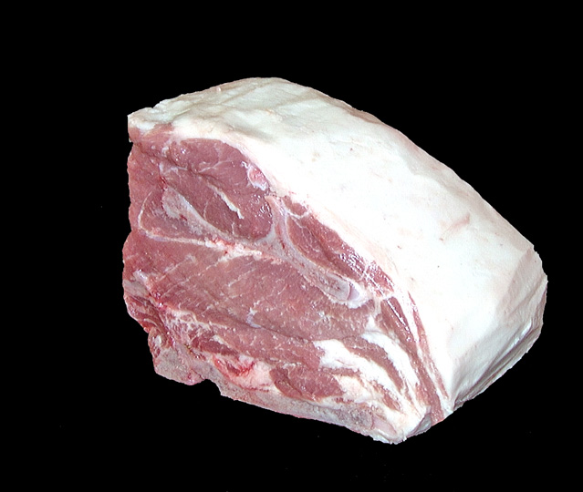
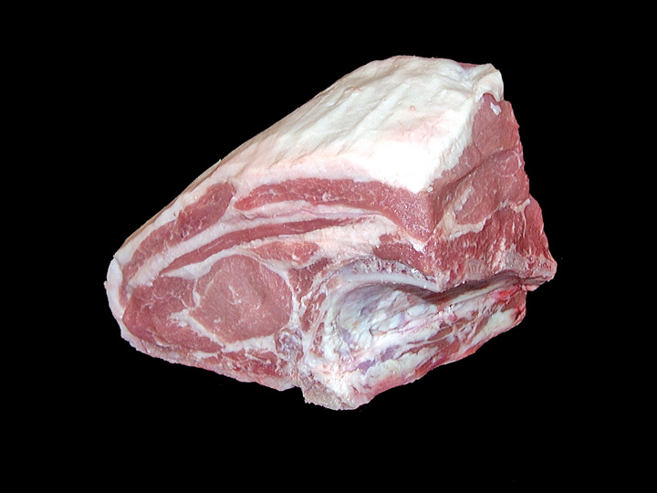
Blade Roast
P – Pork
F – Loin
06 – Blade Roast
D/M – Dry/Moist Cookery

Slide 15
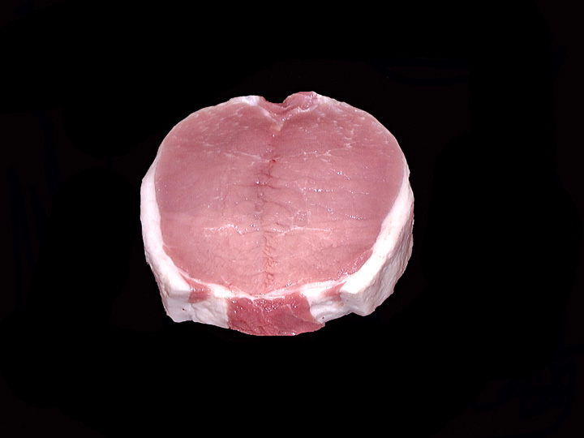
Butterflied Chop (Bnls)
P – Pork
F – Loin
68 – Butterflied Chop (Bnls)
D – Dry Cookery

Slide 16
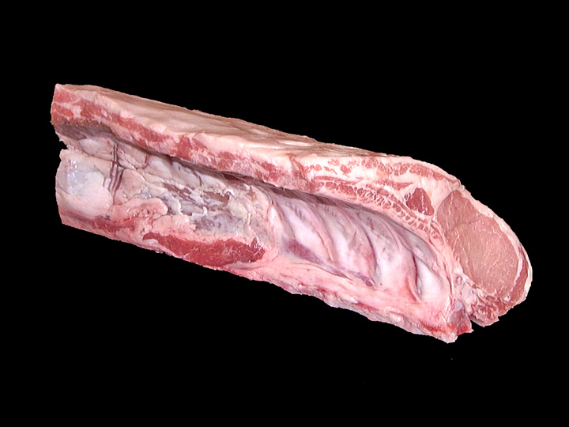
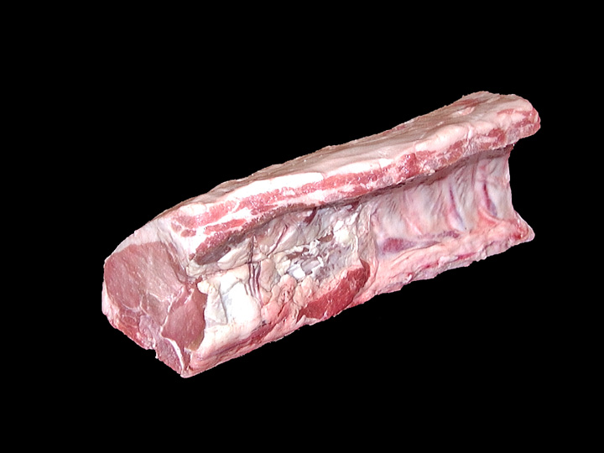
Center Loin Roast
P – Pork
F – Loin
11 – Center Loin Roast
D – Dry Cookery

Slide 17
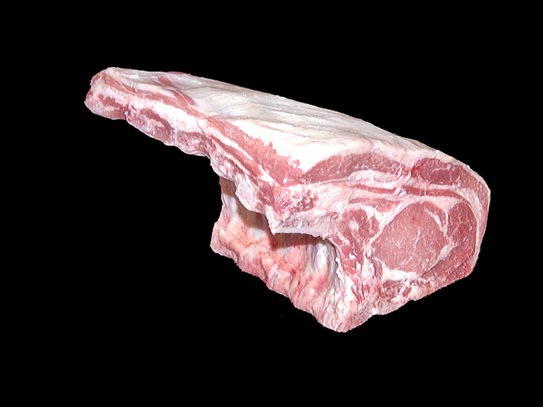
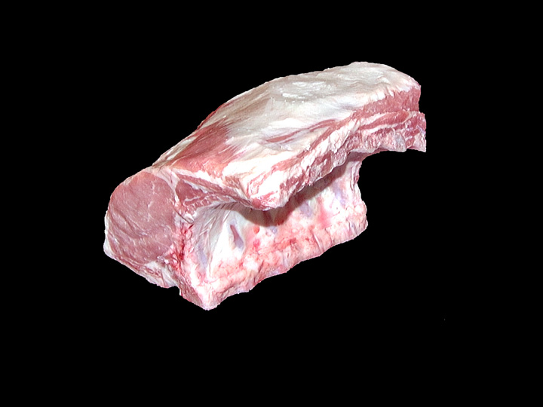
Center Rib Roast
P – Pork
F – Loin
12 – Center Rib Roast
D – Dry Cookery

Slide 18
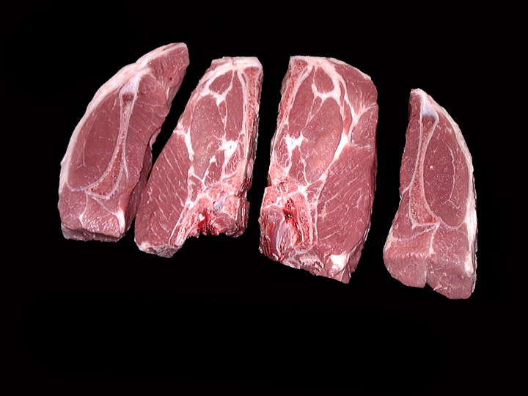
Country Style Ribs
P – Pork
F – Loin
69 – Country Style Ribs
D/M – Dry/Moist Cookery

Slide 19
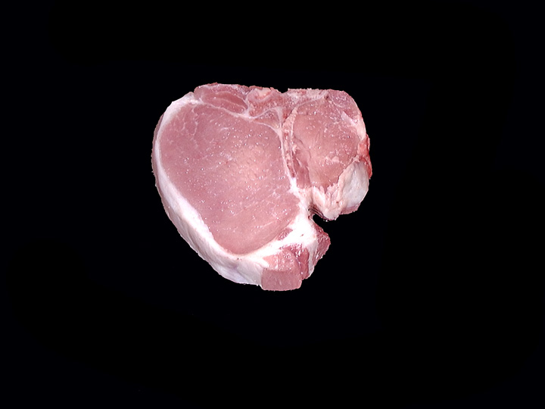
Loin Chop
P – Pork
F – Loin
70 – Loin Chop
D – Dry Cookery

Slide 20
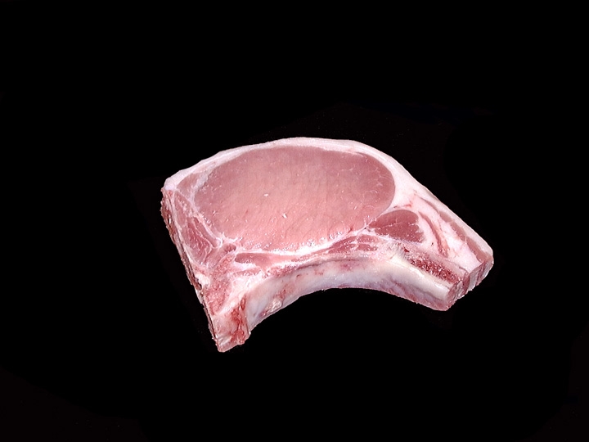
Rib Chop
P – Pork
F – Loin
71 – Rib Chop
D – Dry Cookery

Slide 21
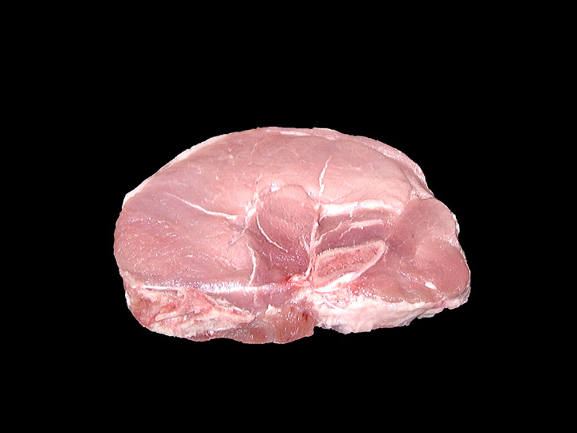
Sirloin Chop
P – Pork
F – Loin
73 – Sirloin Chop
D – Dry Cookery

Slide 22
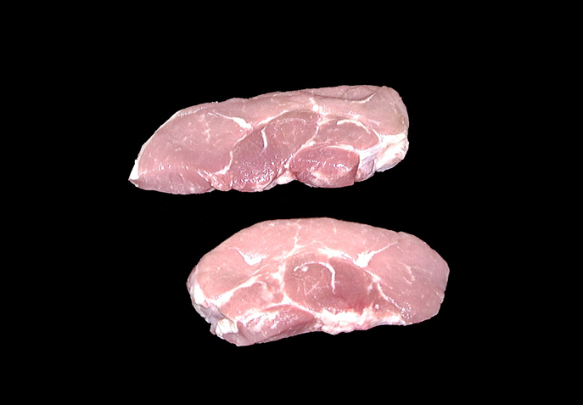
Sirloin Cutlets
P – Pork
F – Loin
53 – Sirloin Cutlets
D – Dry Cookery

Slide 23
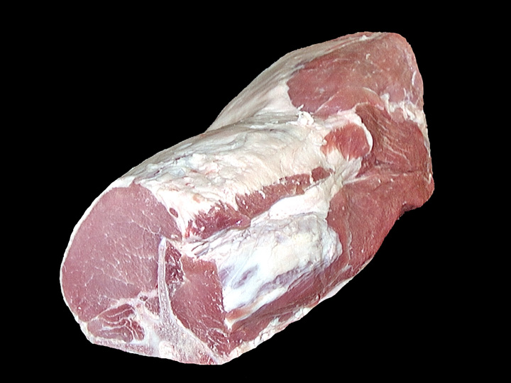
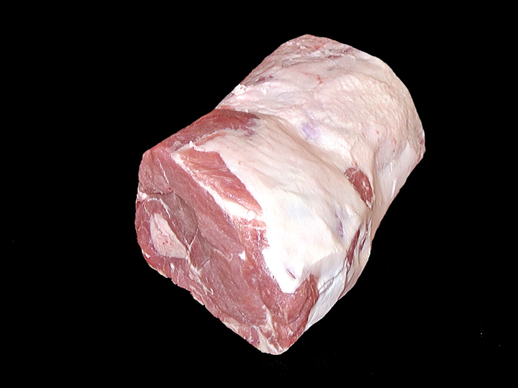
Sirloin Roast
P – Pork
F – Loin
30 – Sirloin Roast
D – Dry Cookery

Slide 24
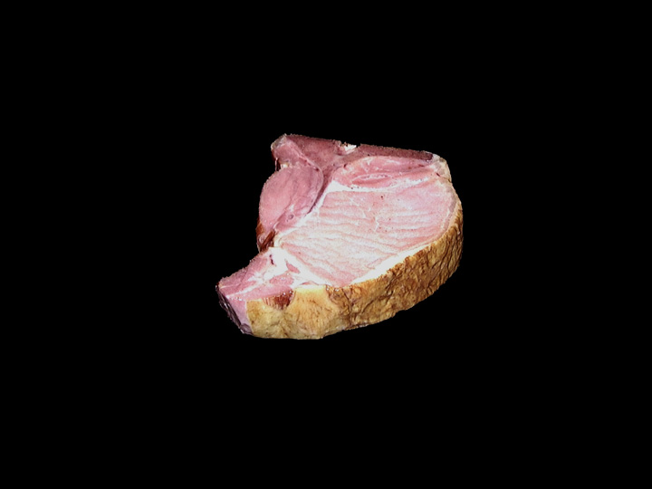
Smoked Loin Chop
P – Pork
F – Loin
93 – Loin Chop
D – Dry Cookery

Slide 25
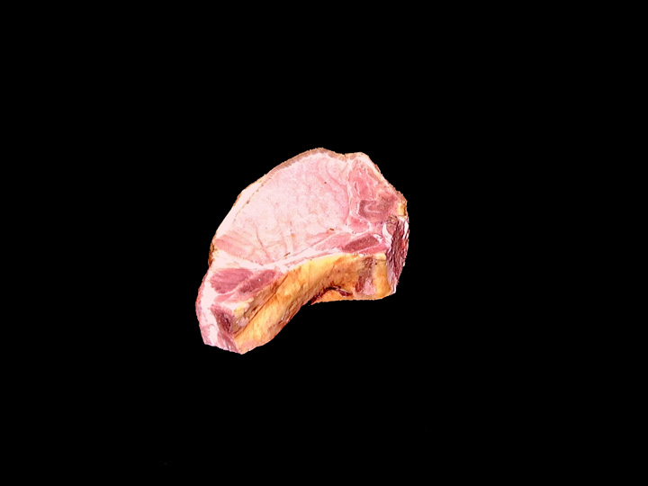
Smoked Rib Chop
P – Pork
F – Loin
95 – Rib Chop
D – Dry Cookery

Slide 26
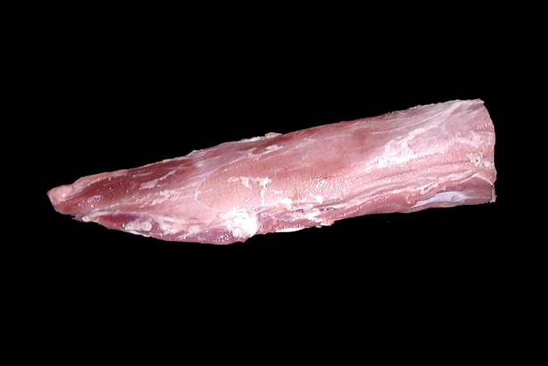
Tenderloin (Whole)
P – Pork
F – Loin
34 – Tenderloin (Whole)
D – Dry Cookery

Slide 27
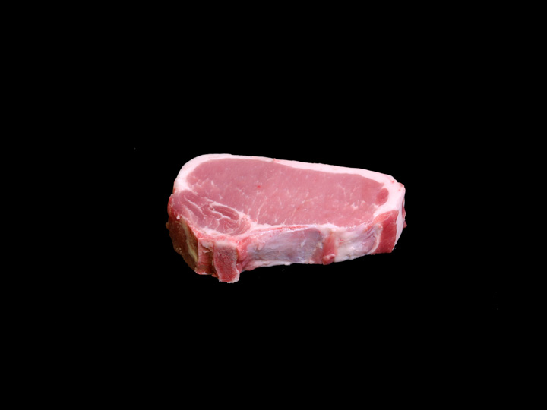
Top Loin Chop
P – Pork
F – Loin
74 – Top Loin Chop
D – Dry Cookery

Slide 28
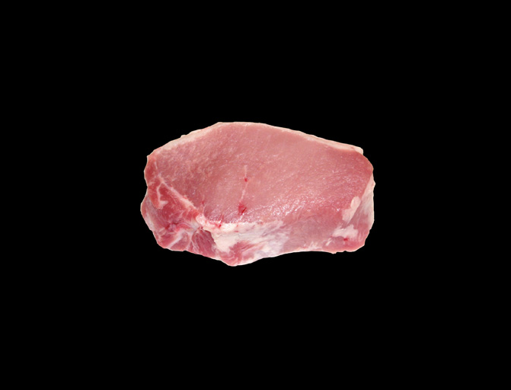
Top Loin Chop (Bnls)
P – Pork
F – Loin
75 – Top Loin Chop (Bnls)
D – Dry Cookery

Slide 29
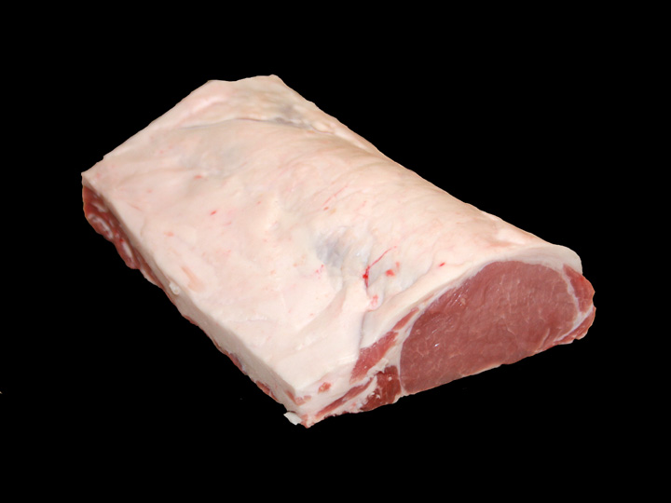
Top Loin Roast (Bnls)
P – Pork
F – Loin
37 – Top Loin Roast (Bnls)
D – Dry Cookery

Slide 30
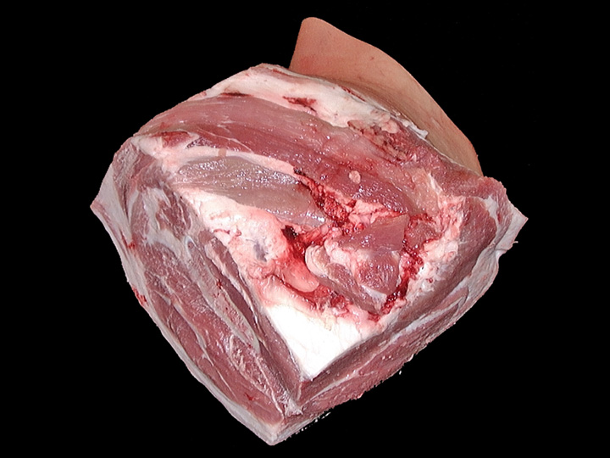
Arm Picnic
P – Pork
J – Shoulder
02 – Arm Picnic
D/M – Dry/Moist Cookery

Slide 31
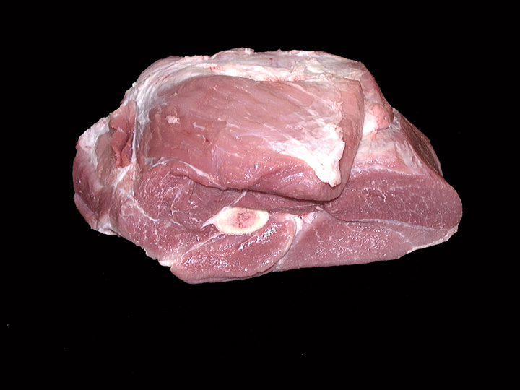
Arm Roast
P – Pork
J – Shoulder
03 – Arm Roast
D/M – Dry/Moist Cookery

Slide 32
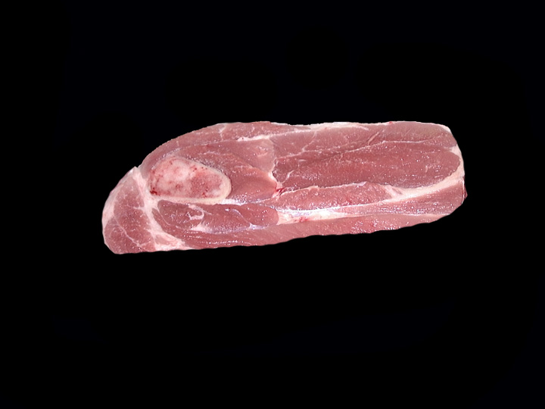
Arm Steak
P – Pork
J – Shoulder
41 – Arm Steak
D/M – Dry/Moist Cookery

Slide 33
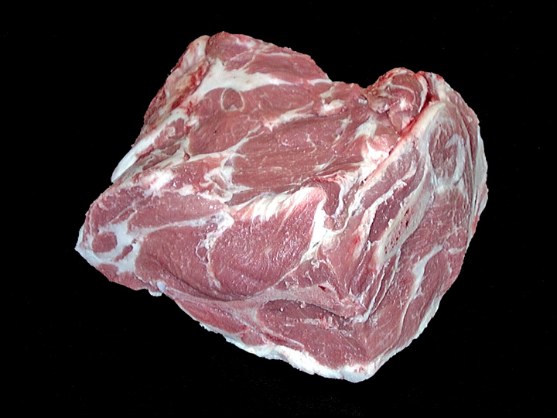
Blade Boston
P – Pork
J – Shoulder
07 – Blade Boston
D/M – Dry/Moist Cookery

Slide 34
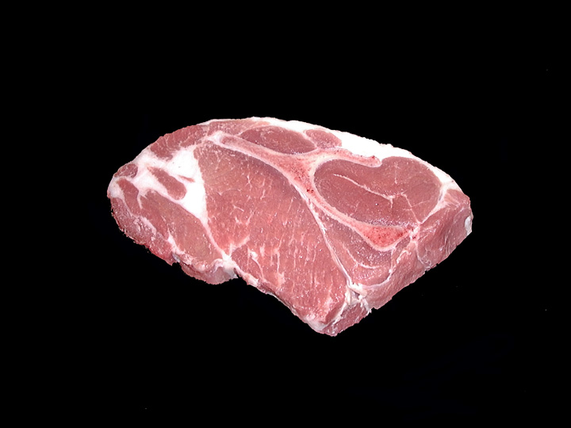
Blade Steak
P – Pork
J – Shoulder
42 – Blade Steak
D/M – Dry/Moist Cookery

Slide 35
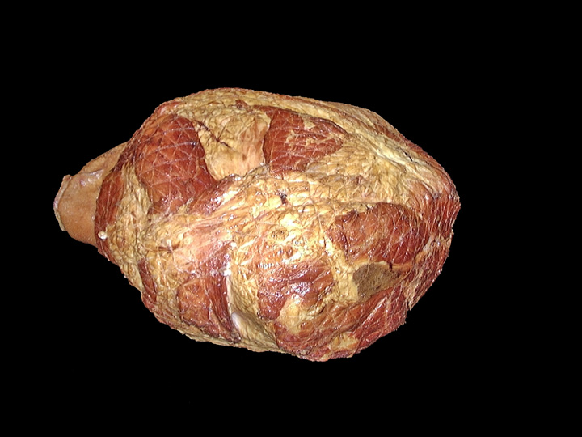
Smoked Picnic (Whole)
P – Pork
J – Shoulder
94 – Picnic (Whole)
D/M – Dry/Moist Cookery

Slide 36
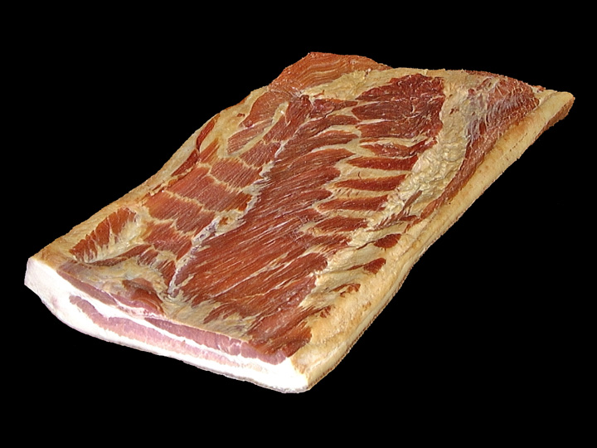
Slab Bacon
P – Pork
K – Side (Belly)
98 – Slab Bacon
D – Dry Cookery

Slide 37
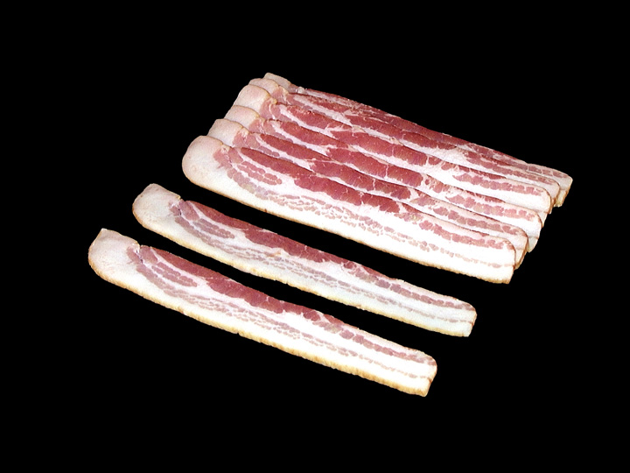
Sliced Bacon
P – Pork
K – Side (Belly)
99 – Sliced Bacon
D – Dry Cookery

Slide 38
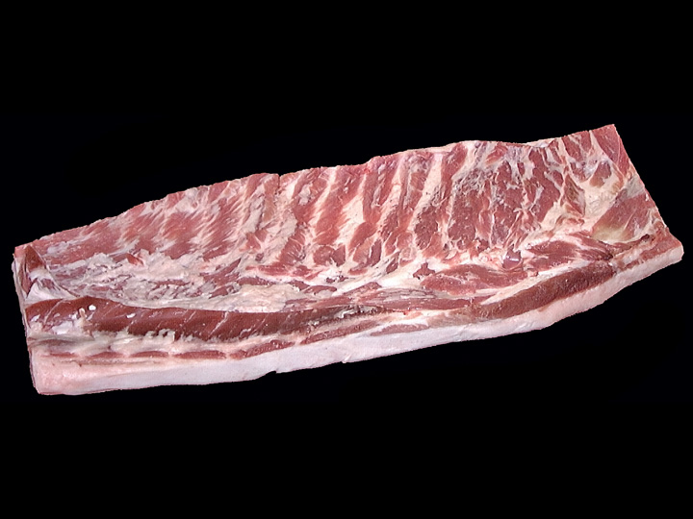
Fresh Side
P – Pork
K – Side (Belly)
17 – Fresh Side
M – Moist Cookery

Slide 39
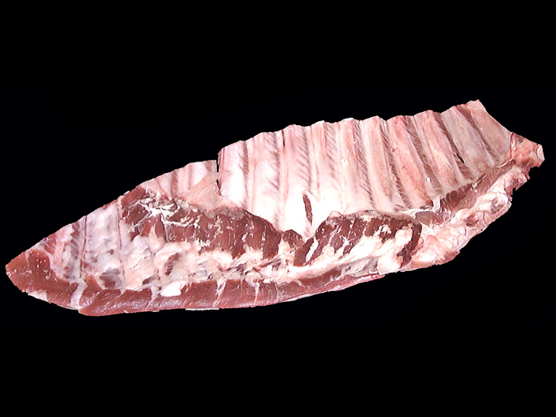
Spareribs
P – Pork
L – Spareribs
32 – Spareribs
D/M – Dry/Moist Cookery

Slide 40
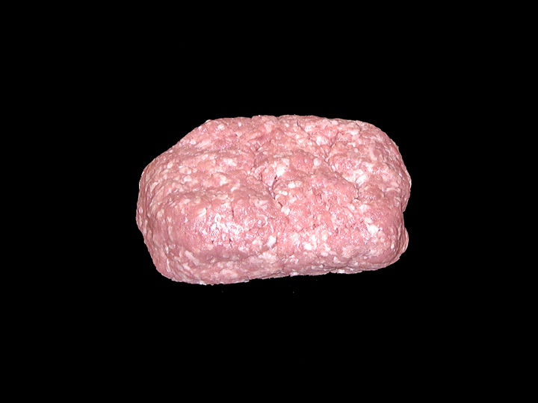
Ground Pork
P – Pork
N – Various Meats
85 – Ground Pork
D – Dry Cookery

Slide 41
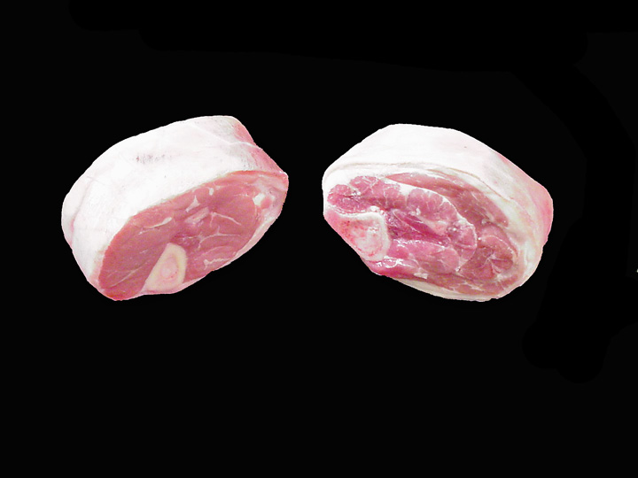
Hocks
P – Pork
N – Various Meats
86 - Hocks
M – Moist Cookery

Slide 42
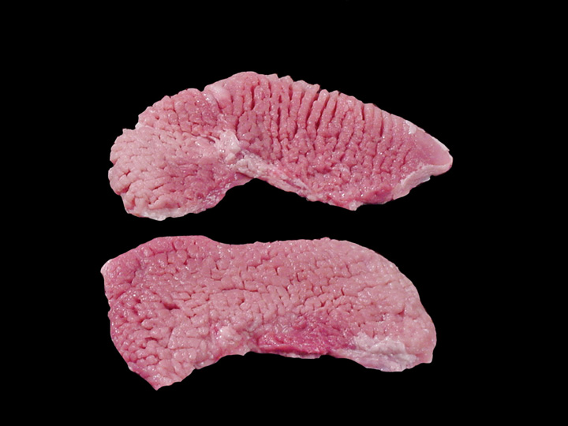
Cubed Steak
P – Pork
N – Various Meats
83 – Cubed Steak
D/M – Dry/Moist Cookery

Slide 43
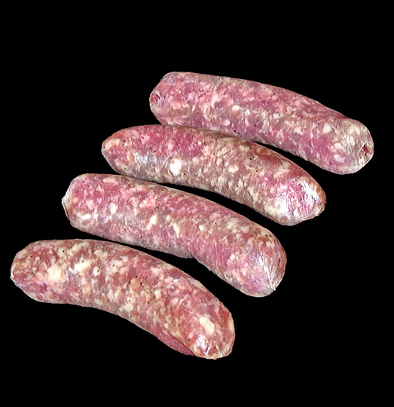
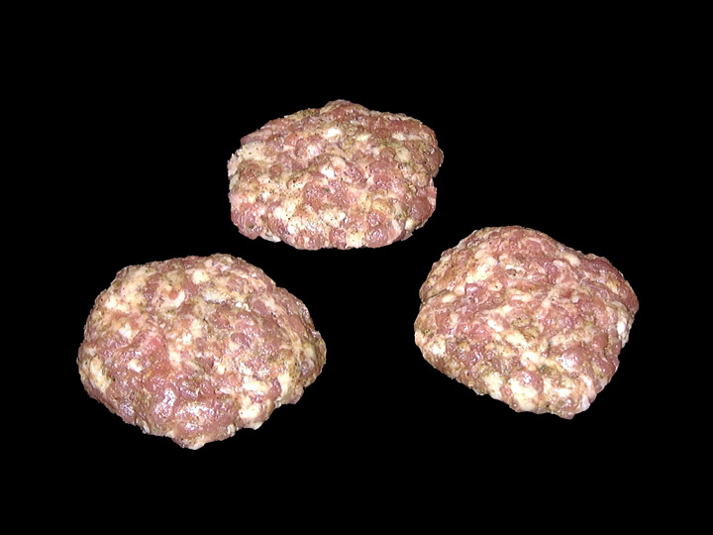
Sausage Link/Pattie
P – Pork
N – Various Meats
87 – Sausage Link/Pattie
D – Dry Cookery

Slide 44
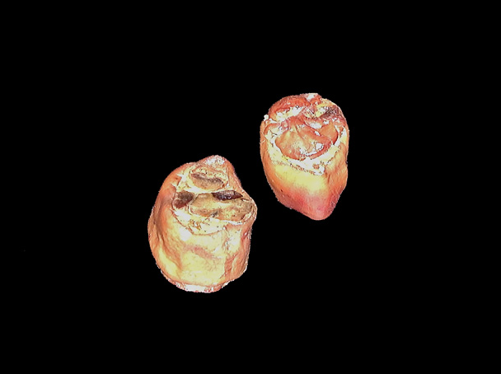
Smoked Hocks
P – Pork
N – Various Meats
92 - Hocks
M – Moist Cookery

